Slide 1
CIS108-6 Data Modelling, Management and Governance
Lecture 2
System Development Life Cycle
Gangmin Li
(Office hours: 13:00-17:00 every Friday)

Slide 2
What we have learnt
Concept of Data and data systems
Data, Information and Knowledge are managed by __systems.
A Computer based system is also called software that used to manage data for business and organisational operational purposes.
Design and develop a data system need a methodology -- A systematic approach!

Slide 3
Lecture outline
What is a system?
System Development Life Cycle (SDLC)
SDLC activities
SDLC phases
System design strategies
System Development models
System Design Tools

Slide 4
Systems and Computer Based Systems

Slide 5
What is a System?
The word System is derived from Greek word Systema, which means an organized relationship between any set of components to achieve some common cause or objective.
A system is “an orderly grouping of interdependent components linked together according to a plan to achieve a specific goal.”

Slide 6
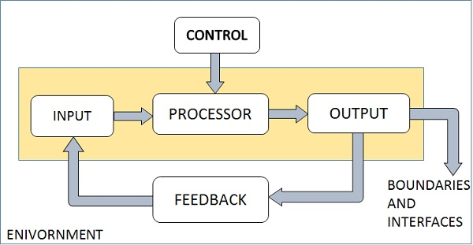
Elements of a System

Slide 7
Elements of a System
Outputs and Inputs
The main aim of a system is to produce an output which is useful for its user.
Inputs are the information that enters into the system for processing.
Output is the outcome of processing.

Slide 8
Elements of a System
Processor(s)
The processor is the element of a system that involves the actual transformation of input into output.
It is the operational component of a system. Processors may modify the input either totally or partially, depending on the output specification.
As the output specifications change, so does the processing. In some cases, input is also modified to enable the processor for handling the transformation.

Slide 9
Elements of a System
Control
The control element guides the system.
It is the decision–making element that controls the pattern of activities
Governing input, processing, and output.

Slide 10
Elements of a System
Environment
The environment is the “supersystem” within which a system operates.
It is the source of external elements that strike on the system.
It determines how a system must function.
In busines, vendors and competitors of organization’s environment, may provide constraints that affect the actual performance of the business.
In Computer, the operating system , the memory capacity and the internet connections are the common environmental elements that affect the system performance.

Slide 11
Elements of a System
Boundaries and Interface
A system should be defined by its boundaries. Boundaries are the limits that identify its components, processes, and interrelationship when it interfaces with another system.
Each system has boundaries that determine its sphere of influence and control.
The knowledge of the boundaries of a given system is crucial in determining the nature of its interface with other systems for successful design.

Slide 12
Computer based systems
Computer Based System − This system is directly dependent on the computer for managing business applications. For example, automatic library system, railway reservation system, banking system, etc.

Slide 13
System (Software) Development Life Cycle (SDLC)

Slide 14
What is SDLC?
System Development Life Cycle (SDLC), also called Software Development Life Cycle, is a conceptual model which define a system develop process used to design and develop a software includes policies and procedures for developing software systems.

Slide 15

SDLC Activities
SDLC typically involves many activities and goes through different development stagiest
Requirements Engineering
Design
Implementation
Testing
Deployment
Operations
Maintenance

Slide 16


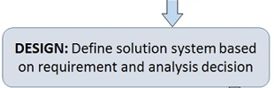


Phases of SDLC
Planning
Analysis
Design
Implementation
Maintenance
Notes:
Aims and objectives of DMM unit

Slide 17
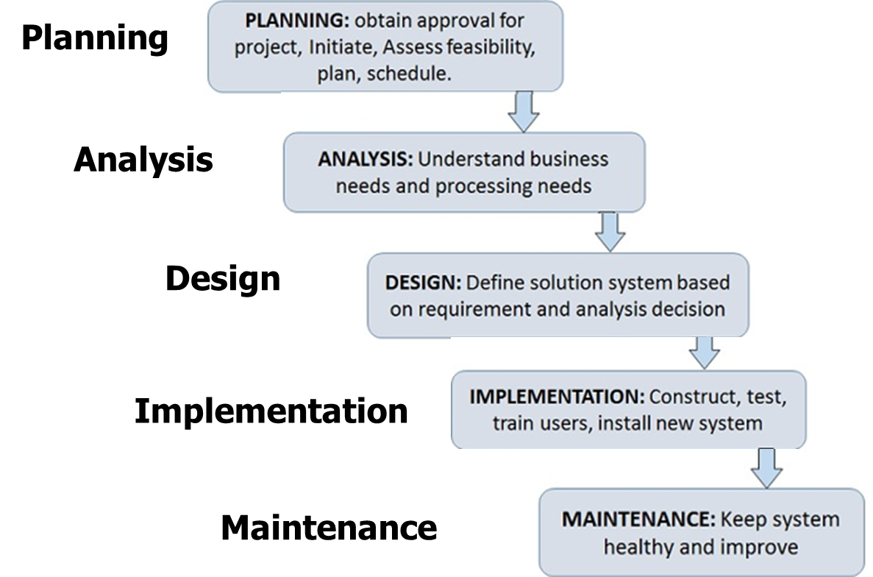
A simple 3 phase design process
Conceptual design
Logical Design
Physical Design

Slide 18
1. Planning and Feasibility Study
Define the problem and scope of the system.
Overview the new system and determine its objectives.
Confirm project feasibility and produce the project Schedule.
During this phase, threats, constraints, integration and security of system are also considered.
A feasibility report for the entire project is created at the end of this phase.
Feasibility report

Slide 19
2. Analysis and Specification
Gather, analyse, and validate the information.
Define the requirements and prototypes for new system.
Evaluate the alternatives and prioritize the requirements.
Examine the information needs of end-user and enhances the system goal.
A System Requirement Specification (SRS) document, which specifies the software, hardware, functional, and network requirements of the system is prepared at the end of this phase.
System Requirement Specification (SRS)

Slide 20
3. System Design
Includes the design of databases, user interfaces, and system interfaces.
Transform the SRS document into logical structure, which contains detailed and complete set of specifications that can be implemented in a programming language.
Create a contingency, training, maintenance, and operation plan.
Review the proposed design. Ensure that the final design must meet the requirements stated in SRS document.
Finally, prepare a design document which will be used during next phases.
Logic Design with technique specification

Slide 21
4. Implementation and Acceptance
Lecture 2 - System Analysis and Design
Implement the design into source code through coding.
Combine all the modules together into testing environment that detects errors and defects.
A test report which contains errors is prepared through test plan that includes test related tasks such as test case generation, testing criteria, and resource allocation for testing.
Integrate the information system into its environment and install the new system.
Physical design and testing report

Slide 22
5. Maintenance and Support
Include all the activities such as phone support or physical on-site support for users that is required once the system is installing.
Implement the changes that software might undergo over a period or implement any new requirements after the software is deployed at the customer location.
It also includes handling the residual errors and resolve any issues that may exist in the system even after the testing phase.
Maintenance and support may be needed for a longer time for large systems and for a short time for smaller systems.

Slide 23
1. System Planning
Requirements Determination (RD) &
Feasibility Analysis

Slide 24
What is Requirements Determination?
A requirement is a vital feature of a new system which may include processing or capturing of data, controlling the activities of business, producing information and supporting the management.
Requirements determination (RD) involves studying the existing system and gathering details to find out what are the requirements, how it works, and where improvements should be made.

Slide 25
Major Activities in RD
Requirements Anticipation
It predicts the characteristics of system based on previous experience which include certain problems or features and requirements for a new system.
It can lead to analysis of areas that would otherwise go unnoticed by inexperienced analyst. But if shortcuts are taken and bias is introduced in conducting the investigation, then requirement Anticipation can be half-baked.

Slide 26
Major Activities in RD
Requirements Investigation
It is studying the current system and documenting its features for further analysis.
It is at the heart of system analysis where analyst documenting and describing system features using fact-finding techniques, prototyping, and computer assisted tools.

Slide 27
Major Activities in RD
Requirements Specifications
It includes the analysis of data which determine the requirement specification, description of features for new system, and specifying what information requirements will be provided.
It includes analysis of factual data, identification of essential requirements, and selection of Requirement-fulfillment strategies.

Slide 28
How to Gather Requirements?
Also called fact finding techniques,
is to determine the information requirements of an organization
used by analysts to prepare a precise SRS and that is understood by software engineer, developer and user.

Slide 29
Information gathering techniques
1. Interviewing
Unstructured Interview − The system analyst conducts question-answer session to acquire basic information of the system.
Structured Interview − It has standard questions which user need to respond in either close (objective) or open (descriptive) format.

Slide 30
Information gathering techniques
2. Questionnaires
Open-ended Questionnaires − It consists of questions that can be easily and correctly interpreted. They can explore a problem and lead to a specific direction of answer.
Closed-ended Questionnaires − It consists of questions that are used when the systems analyst effectively lists all possible responses, which are mutually exclusive.

Slide 31
Information gathering techniques
3. Review of related documents
Review of existing system documents (specification, design report, implementation report, technological report, updating report. Operation records, procedures, and various of forms, user feedbacks, …
Helps to seek insight into a system which describes the current system capabilities, its operations, and performance.

Slide 32
Information gathering techniques
4. Observation
This is a method of gathering information by noticing and observing the people (roles), events (activities), and objects (responsibilities).
The analyst visits the organization to observe the working of current system and understands the requirements of the system.
Find the data flow in the organization and any format transformations.

Slide 33
Information gathering techniques
5. Research and Background Reading
This method is widely used for information gathering by accessing the relevant information.
It includes academic research papers, reviews, and white papers, future trend report.
Any previously gathered information used by the marketer from any internal or external source.
Similar systems
Benchmarkings

Slide 34
Feasibility Study
Feasibility Study can be considered as preliminary investigation that helps the management to take decision about the system should be developed or not.
It identifies the possibility of improving an existing system, developing a new system.
It is used to obtain the outline of the problem and decide whether feasible or appropriate solution exists or not.
The main objective of a feasibility study is to acquire problem scope instead of solving the problem.
The output of a feasibility study is a formal system proposal act as decision document which includes the complete nature and scope of the proposed system.

Slide 35
Steps in Feasibility Analysis
Form a project team and appoint a project leader.
Develop system flowcharts.
Identify the deficiencies of current system and set goals.
Enumerate the alternative solution or potential candidate system to meet goals.
Determine the feasibility of each alternative such as technical feasibility, operational feasibility, etc.
Weight the performance and cost effectiveness of each candidate system.
Rank the other alternatives and select the best candidate system.
Prepare a system proposal of final project directive to management for approval.

Slide 36
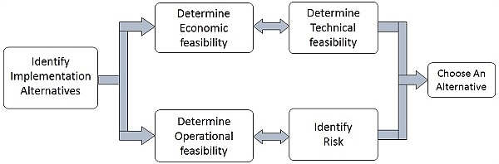
Feasibility Analysis

Slide 37
Economic Feasibility Analysis
It is evaluating the effectiveness of candidate system by using cost/benefit analysis method.
It demonstrates the net benefit from the candidate system in terms of benefits and costs to the organization.
The main aim of Economic Feasibility Analysis (EFS) is to estimate the economic requirements of candidate system before investments funds are committed to proposal.
It prefers the alternative which will maximize the net worth of organization by earliest and highest return of funds along with lowest level of risk involved in developing the candidate system.

Slide 38
Technical Feasibility Analysis
It investigates the technical feasibility of each implementation alternative.
It analyses and determines whether the solution can be supported by existing technology or not.
The analyst determines whether current technical resources be upgraded or added it that fulfill the new requirements.
It ensures that the candidate system provides appropriate responses to what extent it can support the technical enhancement.

Slide 39
Operational Feasibility Analysis
It determines whether the system is operating effectively once it is developed and implemented.
It ensures that the management should support the proposed system and its working feasible in the current organizational environment.
It analyzes whether the users will be affected and they accept the modified or new business methods that affect the possible system benefits.
It also ensures that the computer resources and network architecture of candidate system are workable.

Slide 40
User and time related Feasibility
User Behavioural Feasibility
It evaluates and estimates the user attitude or behaviour towards the development of new system.
It helps in determining if the system requires special effort to educate, retrain, transfer, and changes in employee’s job status on new ways of conducting business.
Schedule Feasibility
It ensures that the project should be completed within given time constraint or schedule.
It also verifies and validates whether the deadlines of project are reasonable or not.

Slide 41
2. System Requirements Analysis
To produce System Design Specification

Slide 42
Ideal SRS Document
Complete, Unambiguous, and Jargon-free.
Specify operational, tactical, and strategic information requirements.
Solve possible disputes between users and analyst.
Clear and accurate requirements
Use graphical aids (later) to simplify understanding of design.

Slide 43
The common analysis paradigms
System Requirements Analysis refers to activities that understand, describe and communicate the system to be built by means of various tools
Mostly graphical tools are used to analyse and refine the objectives of an existing system and develop a new system specification which can be easily understandable by user.
The most common analysis paradigms is Structured analysis (process-oriented approach) (now days OOD is also popular)

Slide 44
What is Structured Analysis?
Structured Analysis is a development method that allows the analyst to understand the system and its activities in a logical way.
It is a systematic process-oriented approach, which has following attributes −
It is graphic (Data flow diagram) which specifies the presentation of application.
It divides the processes so that it gives a clear picture of system flow.
It is logical rather than physical i.e., the elements of system do not depend on vendor or hardware.
It is an approach that works from high-level overviews to lower-level details.

Slide 45
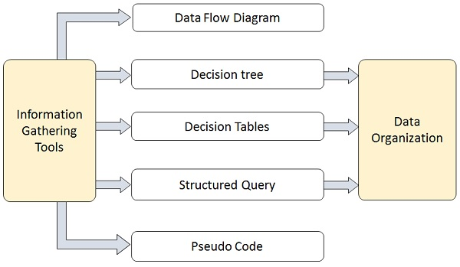
Structured Analysis Tools
Entity relationship models
Process specifications
data dictionaries

Slide 46
Data Flow Diagrams (DFD)
A technique developed by Larry Constantine to express the requirements of system in a graphical form.
It shows the flow and storage of as well as the processes that respond to and change data.
It is an initial stage of design phase that functionally divides the requirement specifications down to the lowest level of detail.
Its graphical nature makes it a good communication tool between user and analyst or analyst and system designer.
It gives an overview of what data a system processes, what transformations are performed, what data are stored, what results are produced and where they flow.

Slide 47
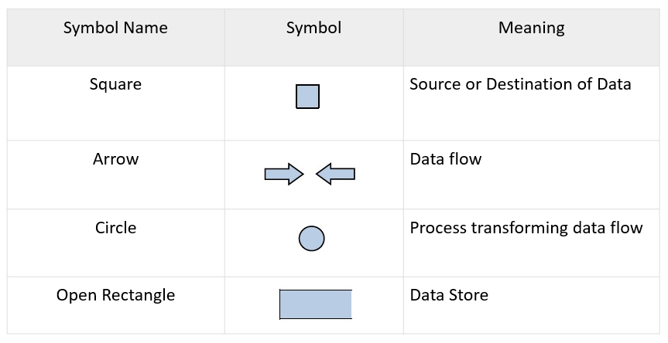
Basic Elements of DFD

Slide 48
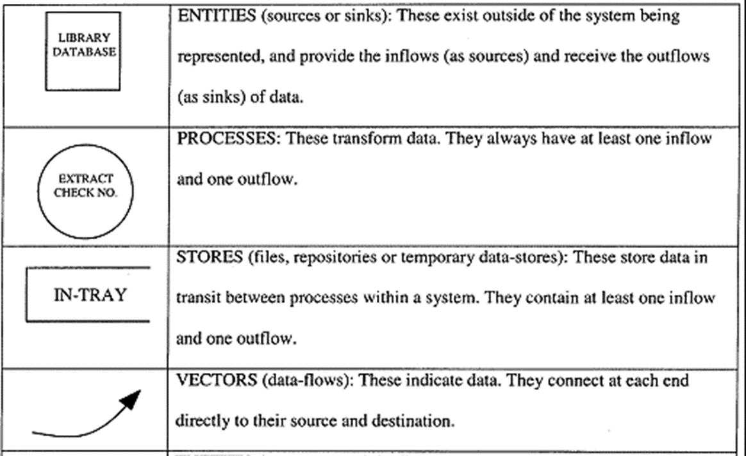
Basic Elements of DFD

Slide 49
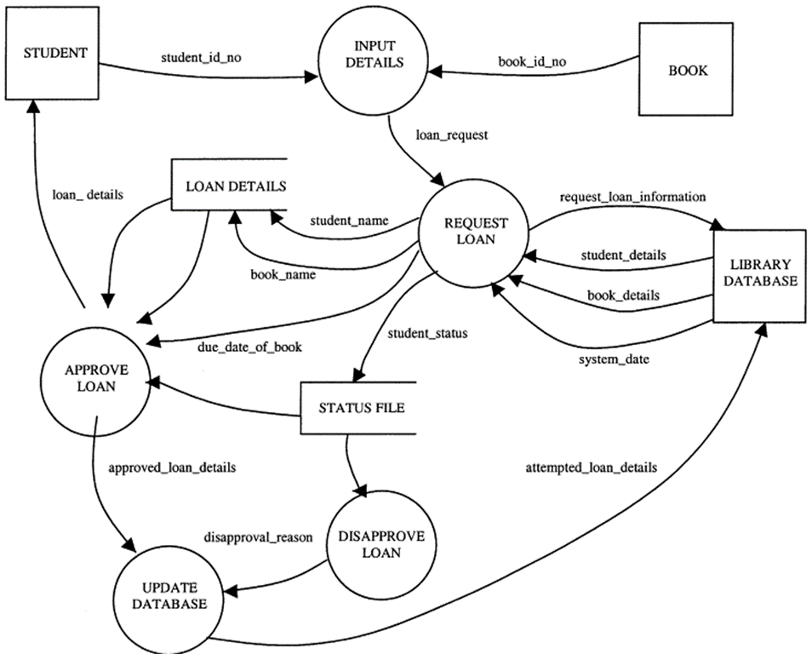
An Example of DFD

Slide 50
Entity-relationship diagram (ERD)
A data modelling technique that creates a graphical representation of the entities, attributes and the relationships between entities, within an information system.
Defining the entities, their attributes, and showing the relationships between them, an ER diagram can show the logical structure of databases. So, it is widely used in sketch out a design of a new database. (later)

Slide 51




Common ERD Symbols
Entities, which are represented by rectangles. An entity is an object or concept about which you want to store information.
Relationships, which are represented by diamond shapes, show how two entities share information in the database.
Attributes, which are represented by ovals. A key attribute is the unique, distinguishing characteristic of the entity. For example, an employee's social security number might be the employee's key attribute.
Cardinality specifies the numerical attribute of the relationship between entities. It can be one-to-one, many-to-one, or many-to-many.

Slide 52
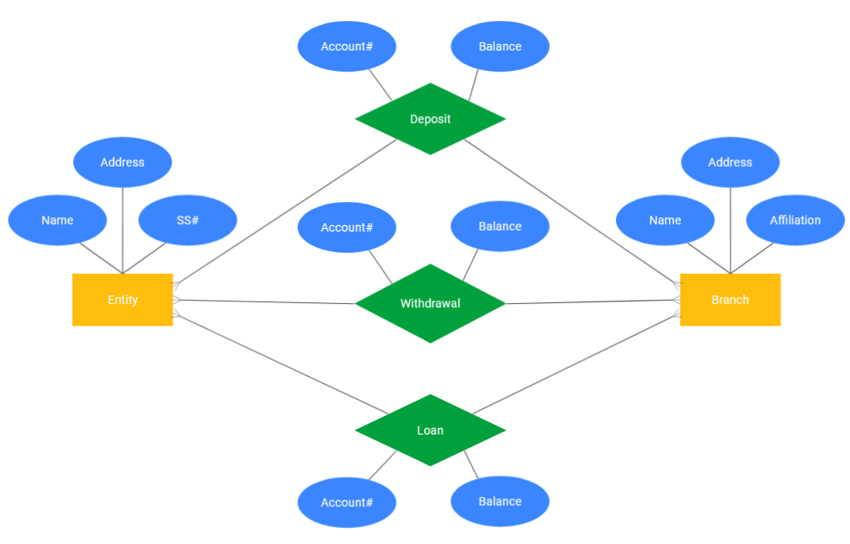
An Example of ERD

Slide 53
3. System Design
Logic Design
Where the SRS document is converted into a format that can be implemented and decides how the system will operate.

Slide 54
Input and Output of SD
Inputs to System Design
Statement of work (function statement) and Requirement determination and feasibility analysis report.
Current situation analysis (user case diagram) and proposed System Requirements Specification (conceptual data model, DFDs, or ERD).
Outputs for System Design
Infrastructure for the proposed system.
A data schema, often a relational schema.
Metadata to define the tables/files and columns/data-items.
A function hierarchy diagram or web page map that graphically describes the program structure.
Actual or pseudocode for each module in the program.

Slide 55
Types of System Design
Logical Design: produce an abstract representation of the system.
Architectural Design: describes the structure and behaviour of the system. It defines the structure and relationship between various modules of system development process.
Data Modelling: captures organizational data which includes all the major entities and relationship.
Data storage design: Describes how the data are stored and accessed (file or DB), choose existing data storage or build your own.

Slide 56
Types of System Design
File Organization: decide how different file (components of the system) are organised. A lot of system call this framework or model. Such as, Laravel, Jekyll, XAMPP, …
Document creation and control:
Documentation is a process of recording the information for any reference or operational purpose.

Slide 57
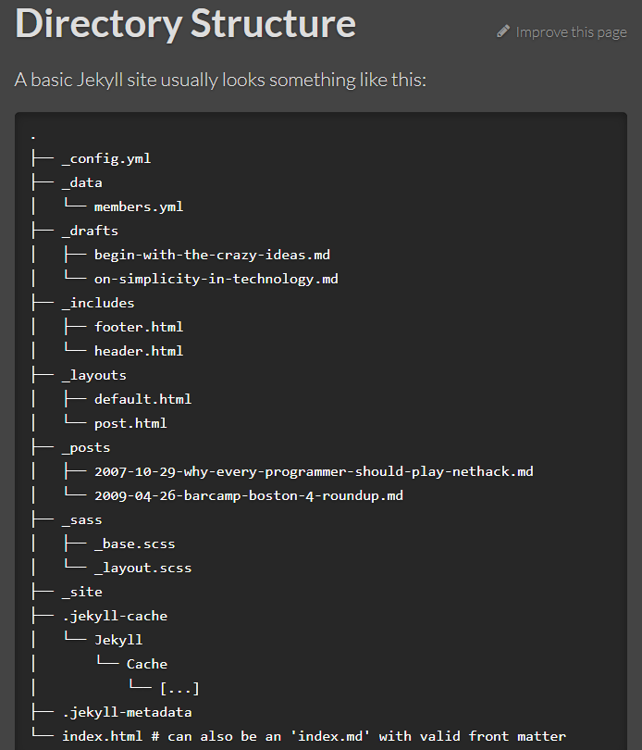
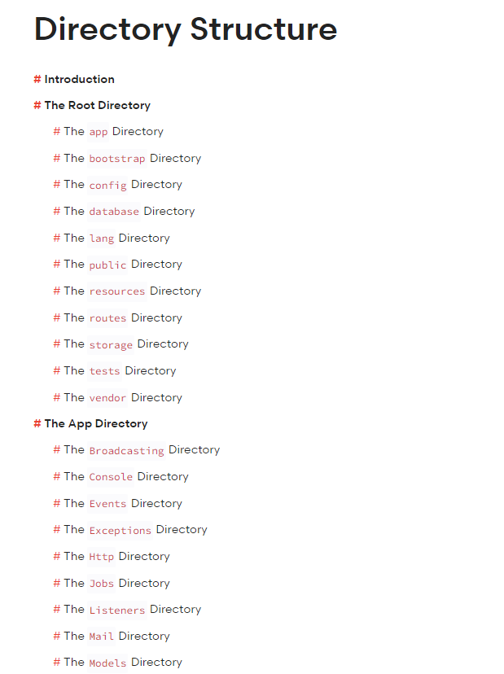
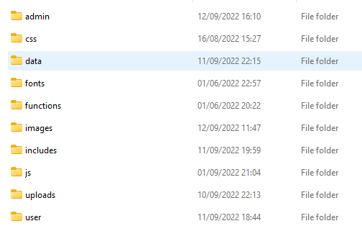
Examples
File Organization: Laravel, Jekyll, XAMPP, …

Slide 58
Types of documentation
Program documentation (Technical report): It describes inputs, outputs, and processing logic for all the program modules.
System documentation (Technical specifications) provides the basis for understanding the technical aspects of the IS when modifications are made.
Operations documentation: contains all the information needed for system to be operational. It includes, installation, configuration, and operation manuals.
User documentation (User manual) It includes instructions and information to the users who will interact with the system. Help guides and tutorials.

Slide 59
4. Implementation and Acceptance
Implementation is a process of ensuring that the information system is operational. It involves −
Constructing a new system from scratch and allows the users to take over its operation for use and evaluation.

Slide 60
System Implementation
Implementation is a process of ensuring that the information system is operational. In a general system it may utilised by training and conversion.
For a software system it means (physical design):
Coding: convert design into executable through computer languages.
Trial：run designed system for a taste of its design.
Testing：run designed system against design documents and system specification.
（Trial and testing together sometimes called hand=over or acceptance）

Slide 61
Coding
Coding is the process of transforming the design of a system into a computer language format. It actually translating the design specification into the source code.
Coding is done by the coder or programmers who are independent people than the designer.
Goals of Coding:
To translate the design of system into a computer language format
To reduce the cost of later phases
Making the program more readable

Slide 62
Trial
Trial refers to a process of taste (rise awareness) or test of a system or product.
A trial version of a software refers to a product that has reduced functionality or limited time to use and mostly free.
Trial version software: “alpha version” and “beta version”
“alpha version” is called pre-release version. It is an internal company testing phase that testers are using white box testing to look at source code and evaluate products.
After the alpha phase, there is a “beta phase” where a beta version of software is released to a specific group of users who suing black box techniques for testing: rather than looking at source code, users run the programs and see whether any bugs or glitches are evident.

Slide 63
Testing
Testing is the process or activity that checks the functionality and correctness of software according to specified user requirements in order to improve the quality and reliability of system.
Types of Testing:
Unit Testing Also known as Program Testing, it is a type of testing where the analyst tests or focuses on each program or module independently.
Integration Testing, tests multiple module working together.
Function Testing determines whether the system is functioning correctly according to its specifications and relevant standards documentation.
Stress Testing determines the robustness and scalability of a software product by testing beyond its normal operation limits.

Slide 64
Stages of system testing
Test Strategy: It is a statement that provides information about the various levels, methods, tools, and techniques used for testing the system. It should satisfy all the needs of an organization
Test Plan: It provides a plan for testing the system and verifies that the system under testing fulfils all the design and functional specifications.
Test Case Design: identify actual use cases for each module of the system to be tested.
Test Execution: execute each of the test cases.
Test Result Documentation: record the total number of test cases executed, the number of errors, and nature of errors.

Slide 65
Quality Assurance
Quality Assurance is the review of system or software products and its documentation for assurance that system meets the requirements and specifications.
Software quality Assurance (SQA) is a techniques that includes procedures and tools applied by the software professionals to ensure that software meet the specified standard for its intended use and performance.
Levels of Quality Assurance
Code level
Compilation and Linking
Routine Running
System level (overall performance)

Slide 66
5. Maintenance and Support
Keeping system running as it is intended
Provide required service to maintain system in its running condition
System Governance: rules, responsibility and Procedures

Slide 67
System maintenance
System maintenance conforms the system to its original requirements and adds system capability by incorporating new requirements (enhancement).
Maintenance Types:
Corrective Maintenance − Enables user to carry out the repairing and correcting leftover problems.
Adaptive Maintenance − Enables user to replace the functions of the programs.
Perfective Maintenance − Enables user to modify or enhance the programs according to the users’ requirements and changing needs.

Slide 68
System Security
System security refers to protecting the system from theft, unauthorized access and modifications, and accidental or unintentional damage.
In computerized systems, security involves protecting all the parts of computer system which includes data, files, software and hardware.
Systems security also includes system privacy and system integrity.
System privacy deals with protecting individuals systems from being accessed and used without the permission/knowledge of the concerned individuals.
System integrity is concerned with the quality and reliability of raw as well as processed data in the system.

Slide 69
Control methods
Backup:
Regular backup of databases daily/weekly depending on the time criticality and size.
Incremental back up at shorter intervals.
Backup copies kept in safe remote location particularly necessary for disaster recovery.
Duplicate systems run and all transactions mirrored if it is a very critical system and cannot tolerate any disruption before storing in disk.
Physical Access Control to Facilities
Access control:
Logical or Software Control: Password system, Encrypting sensitive data/programs, Antivirus software and Firewall protection while connected to internet.
Physical Access Control: Physical locks and Biometric authentication. For example, finger print, ID cards or entry passes being checked by security staff.

Slide 70
System Design Strategies

Slide 71
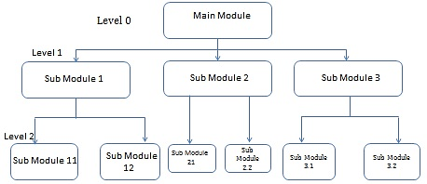
Design Strategies
Top-Down Strategy: The top-down strategy uses the modular approach to develop the design of a system. It starts from the top or the highest-level module and moves towards the lowest level modules.

Slide 72
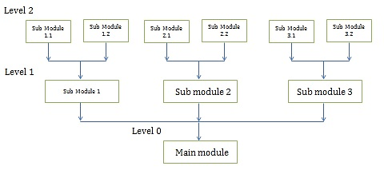
Design Strategies
Bottom-Up Strategy: It also follows the modular approach to develop the design of the system. It however starts from the bottom or the most basic level modules and moves towards the highest level modules.

Slide 73
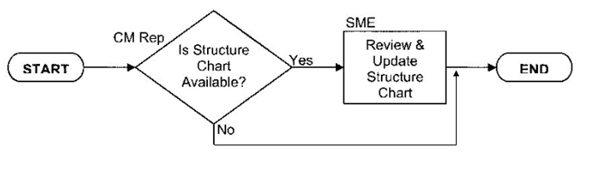
Design Strategies
Structured Design: (functional design) It is a data-flow based methodology that helps in identifying the input and output of the developing system. In a software development, it is based on DFDs. After developing the DFDs for the software system, the next step is to develop the structure chart.

Slide 74
Design Strategies
Modular Design: (Object Oriented design) views the enterprise as a community of agents, termed objects. Each object is responsible for a specific task. Any tasks in the system is performed by objects or interaction among multiple objects.
An object is an encapsulation of state (data values) and behaviour (operations).
The behaviour of objects is dictated by the rules and principles associated with its object class.
An object will exhibit its behaviour by invoking a method (similar to executing a procedure) in response to a message.
Objects and classes extend the concept of abstract data types by adding the notion of inheritance.

Slide 75
Object Oriented Design Approach
In the object-oriented approach, the focus is on capturing the structure and behaviour of information systems into small modules that combines both data and process.
The main aim of Object Oriented Design (OOD) is to improve the quality and productivity of system analysis and design by making it more usable.
Object Oriented Analysis (OOA)
Object oriented design (OOD)
Object oriented Implementation (OOI)

Slide 76
Object-Oriented Analysis
This phase concerns with determining the system requirements and to understand the system requirements build a use-case model. A use-case is a scenario to describe the interaction between user and computer system. “use case model” represents the user needs or user view of system.
It also includes identifying the classes and their relationships to the other classes in the problem domain, that make up an application.
OOA uses Use case diagram for representation

Slide 77
Use case diagram
Use case diagram was proposed by Ivar Jacobson in 1986.
It is used to identify, clarify, and organize system requirements.
Use case diagrams are employed in UML (Unified Modelling Language) as a standard notation for the modelling of real-world objects and systems.
In the Unified Modelling Language (UML), a use case diagram is a subclass of behavioural diagrams. (later)

Slide 78
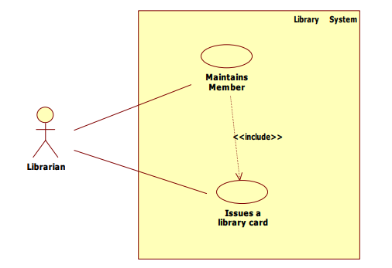
A Use case diagram examples

Slide 79
Object-Oriented Design
The objective of this phase is to design and refine the classes, attributes, methods, and structures that are identified during the analysis phase, user interface, and data access.
This phase also identifies and defines the additional classes or objects that support implementation of the requirement.

Slide 80
Object Oriented Implementation
OOI can have two specific methods: Component-Based Development (CBD) or Rapid Application Development (RAD).
Component-based development (CBD): COD is an industrialized approach to assembly of pre-built, pre-tested, reusable software components that operate with each other to construct a complete new software system.
Tools: CASE
Rapid Application Development (RAD): RAD is a set of tools and techniques that focuses more on process description and combined with the object oriented approach to build applications quickly and incrementally.
Tools: visual basic, power builder, etc.

Slide 81
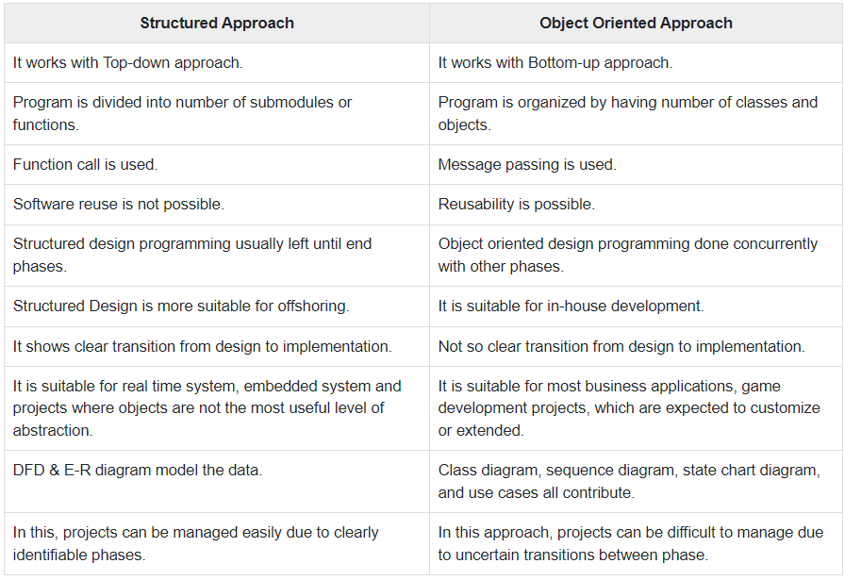
Structured Approach Vs. Object-Oriented Approach

Slide 82
System Development Models

Slide 83
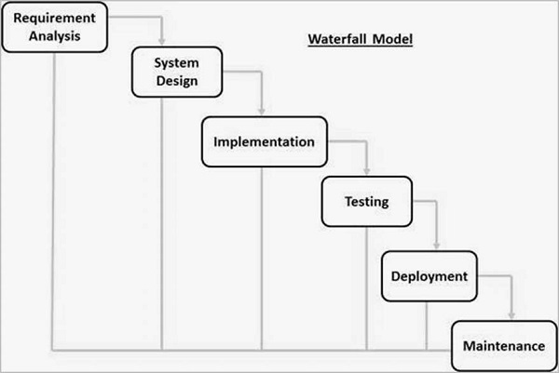
6 system development models https://www.tutorialspoint.com/sdlc/
1. Waterfall Model: A linear-sequential life cycle model. Each phase must be completed before the next phase can begin and there is no overlapping in the phases.

Slide 84
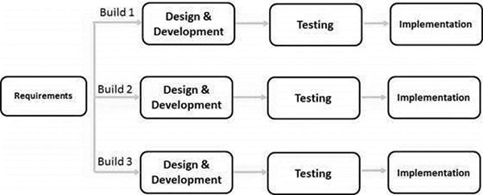
6 system development models
2. Iterative Model: Iterative process starts with a simple implementation of a subset of the software requirements and iteratively enhances the evolving versions until the full system is implemented.

Slide 85
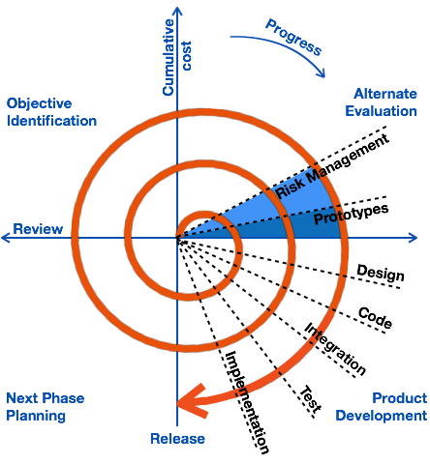
6 system development models
3. Spiral Model combines the idea of iterative development with the systematic, controlled aspects of the waterfall model. It allows incremental releases of the product with more requirements implemented.

Slide 86
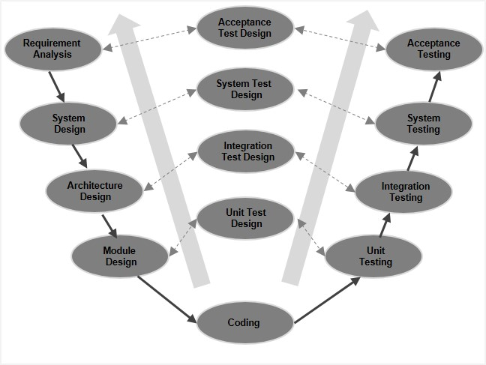
6 system development models
4. V-Model: Verification and Validation model.
The V-Model extents the waterfall model associates a testing phase for each corresponding development stage. For every single phase in the development cycle, there is a directly associated testing phase. The next phase starts only after completion of the previous phase.

Slide 87
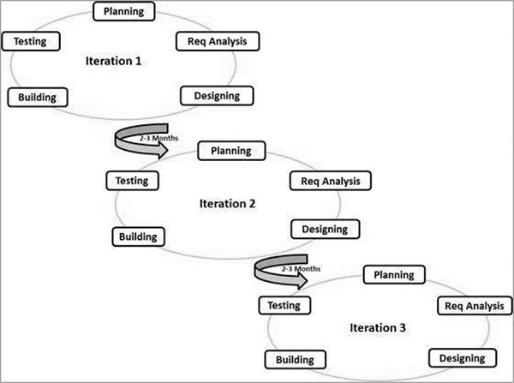
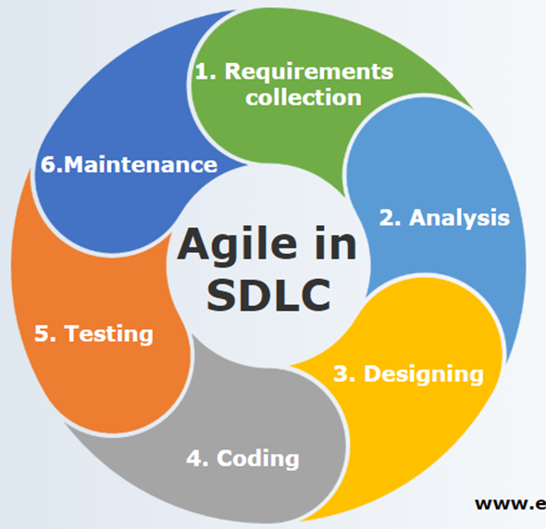
6 system development models
5. Agile Model: adaptive software development methods. It is a combination of iterative and incremental process models. with focus on process adaptability and customer satisfaction by rapid delivery of working software product.

Slide 88
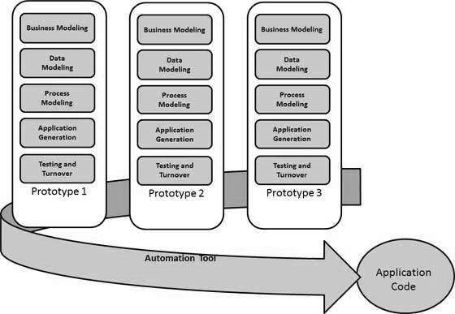
6 system development models
6. RAD Model: The RAD (Rapid Application Development)
model is based on prototyping and iterative development with no specific planning involved.

Slide 89
SDLC Tools

Slide 90
Unified Modelling Language (UML)
UML is a visual language that lets user to model processes, software, and systems to express the design of system architecture.
It is a standard language for designing and documenting a system in an manner that allow technical architects to communicate with developer.
It provides a common vocabulary of object-oriented terms and diagramming techniques that is rich enough to model any systems development project from analysis through implementation.

Slide 91
Element of UML
UML is made up of:
Diagrams − It is a pictorial (graphical) representations of process, system, or some part of it.
Notations − It consists of elements that work together in a diagram such as connectors, symbols, notes, etc.

Slide 92
Summary
A system is an orderly grouping of interdependent components linked together according to a plan to achieve a specific goal
A computer based system is the system is directly dependent on the computer for managing business applications.
The SDLC has 7 activities and 5 phases.
System Design Strategies: top-down, bottom-up, procedural and modular.
The commonly used SDLC models: Waterfall model, Iterative model, Spiral Model, V-shaped model and Agile and RAD model.
The SLDC tools are mainly UML (next lecture)

Slide 93
Review
Data Flow Diagram - Everything You Need to Know About DFD (smartdraw.com)
How to Create Data Flow Diagram (DFD)? (visual-paradigm.com)
https://www.tutorialspoint.com/system_analysis_and_design/system_analysis_and_design_development_life_cycle.htm

